Slide 1
Project Presentation
Capillary Identification
Yifei Jin

Slide 2

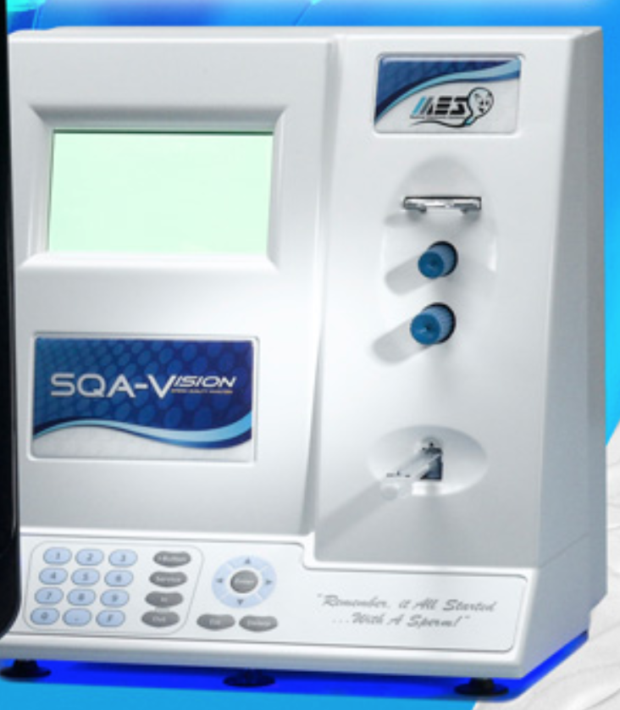
MES Medical
Rapid - Objective - Standardized Semen Analysis Solutions
SQA-V (Sperm Quality Analyzer)
Collect a sample using a dedicated container (capillary)
Perform a test
Get Results
Notes:
Semen Analysis is difficult by manual estimation. MES leads the world in Automated Sperm Quality Analyzers and related testing kits designed to increase accuracy and precision. Standardize your automated or manual semen analysis today
The SQA-V GOLD is a user friendly high performance sperm analysis system used to test male fertility. It combines electro-optics, computer algorithms and video microscopy to provide a precise and accurate 75 second automated semen analysis. The system is in use at thousands of facilities around the world. And report the objective results you require and deserve.

Slide 3
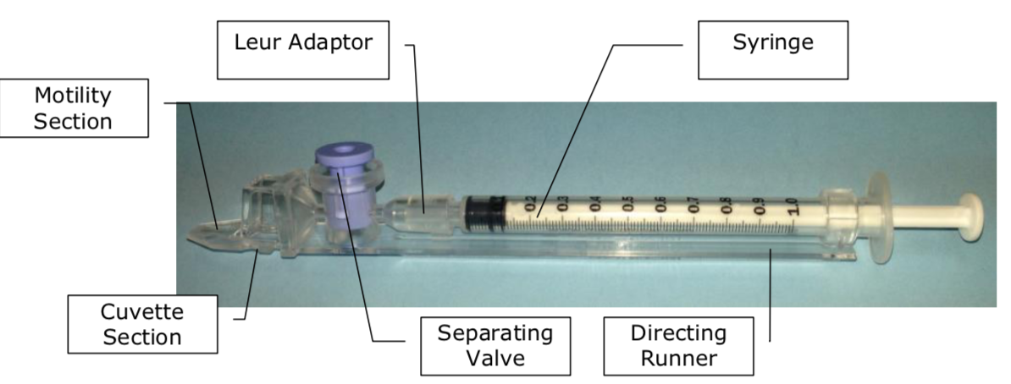
Capillary

Slide 4
Calibration Process
The SQA-Vision devices need to be calibrated before it is used.
A capillary is inserted into a device and a test is performed
The results (Key parameters) for the test are written manually
The same capillary is inserted to the following device and a test is performed
In the same way, the result are written and collected for all devices
Continues with the same capillary and includes the reference devices as well
For each device the results are compared to the references results
Calibration parameters are adjusted if needed

Slide 5
My Project - Capillary Identification
Problems:
Many devices being calibrated together using many capillaries
There might be a confusion on the capillaries & devices
My work:
Help improve the calibration process
Set the basis for automatic calibration
Notes:
The SQA-Vision devices need to be calibrated before using.

Slide 6
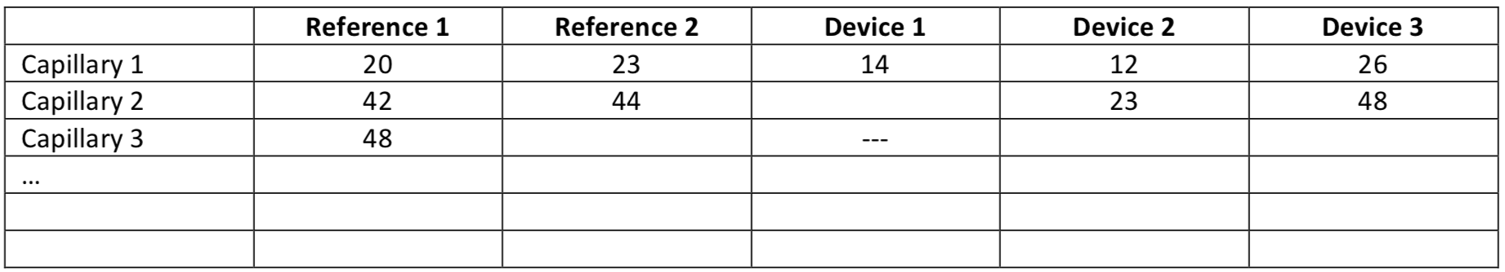
Goal
Develop a solution that allow tracking the capillaries that inserted in each device
The solution should include an automatic capillary identification mechanism
The PC should present always a table/grid with all the measurements that are taken while each row represents different capillary and each column represent a device.

Slide 7
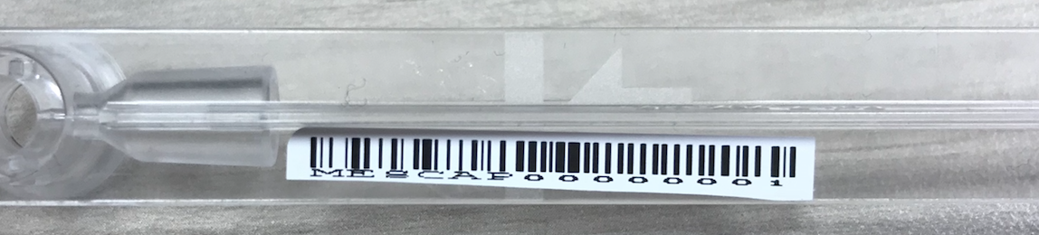
Approach
Create a pre-defined barcode structure to mark each capillary
A barcode reader will be associated to a device
Capillary will be scanned every time before it is inserted to device
The PC will automatically identify the capillary and associate it with the device

Slide 8
Challenges & Solutions
All Bluetooth scanners work as a standard keyboard input
Get the unique id from each Bluetooth scanner and associate it with the selected device
Differentiate each scanner automatically during the identification process
Convert the input source into raw input
Get information from raw input
(Solution) using an existing C# RawInput API for implementing the process and integrate it in the system
Notes:
Chanllanges:
Human Interface Devices (HIDs)
the usual keyboard programming methods in the .NET Framework offer no way to differentiate the input from different keyboards.
Windows XP and above now support a "raw input" API which allows programs to handle the input from any connected human interface devices directly.
Intercepting this information and filtering it for keyboards enables an application to identify which device triggered the message.

Slide 9
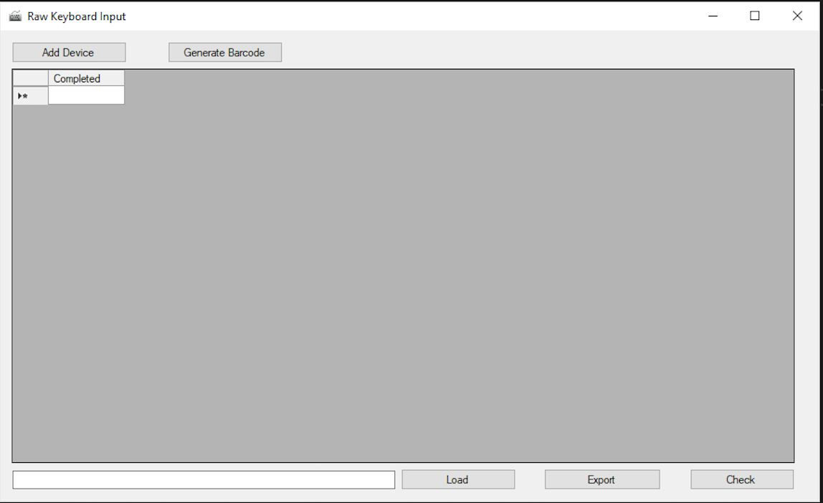
Solution

Slide 10
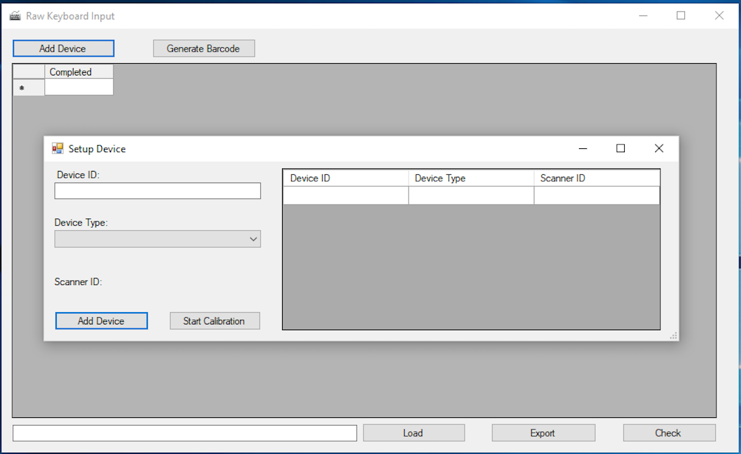
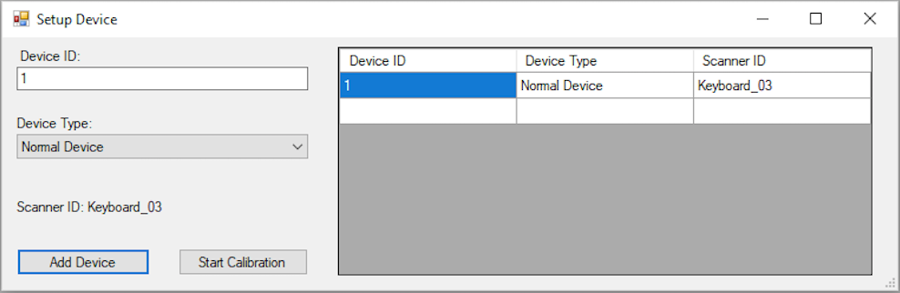

Slide 11
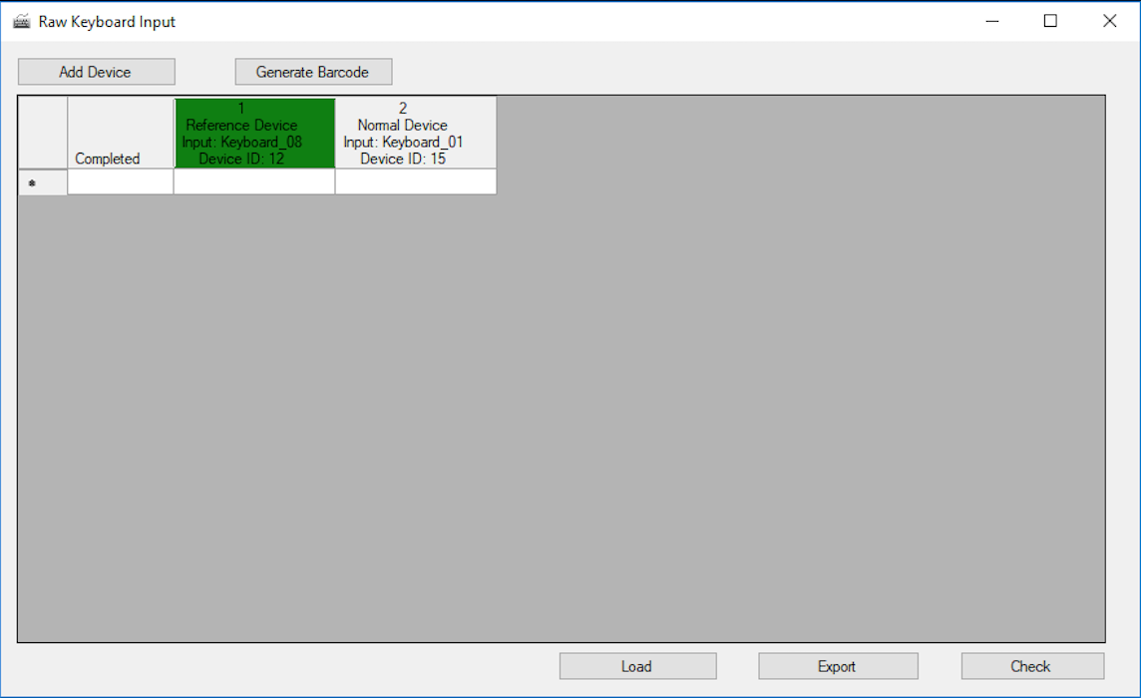
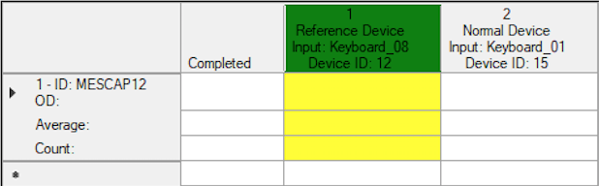
Results will be read automatically from the device

Slide 12
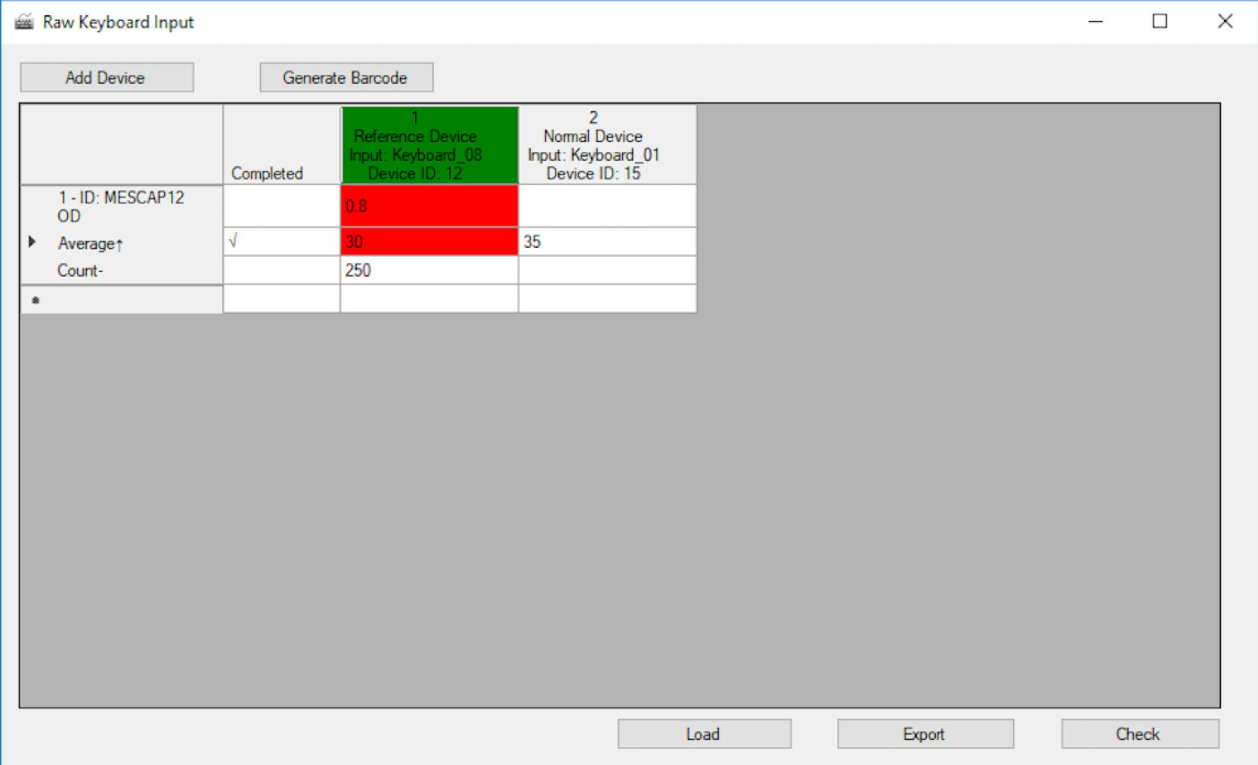
Other features
Export
Load
Barcode
Generator
- Check

Slide 13
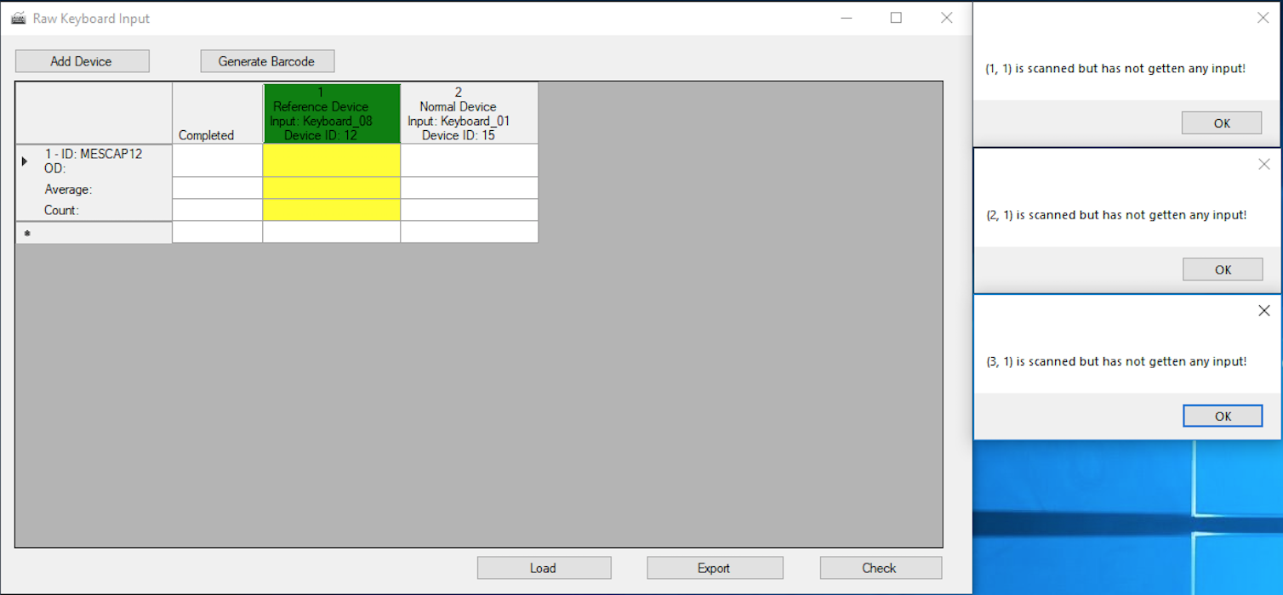
Popup warming after a certain time frame

Slide 14
Thank You

